Slide 1
ParaDrug
Bruno Levecke
28 June 2016

Slide 2
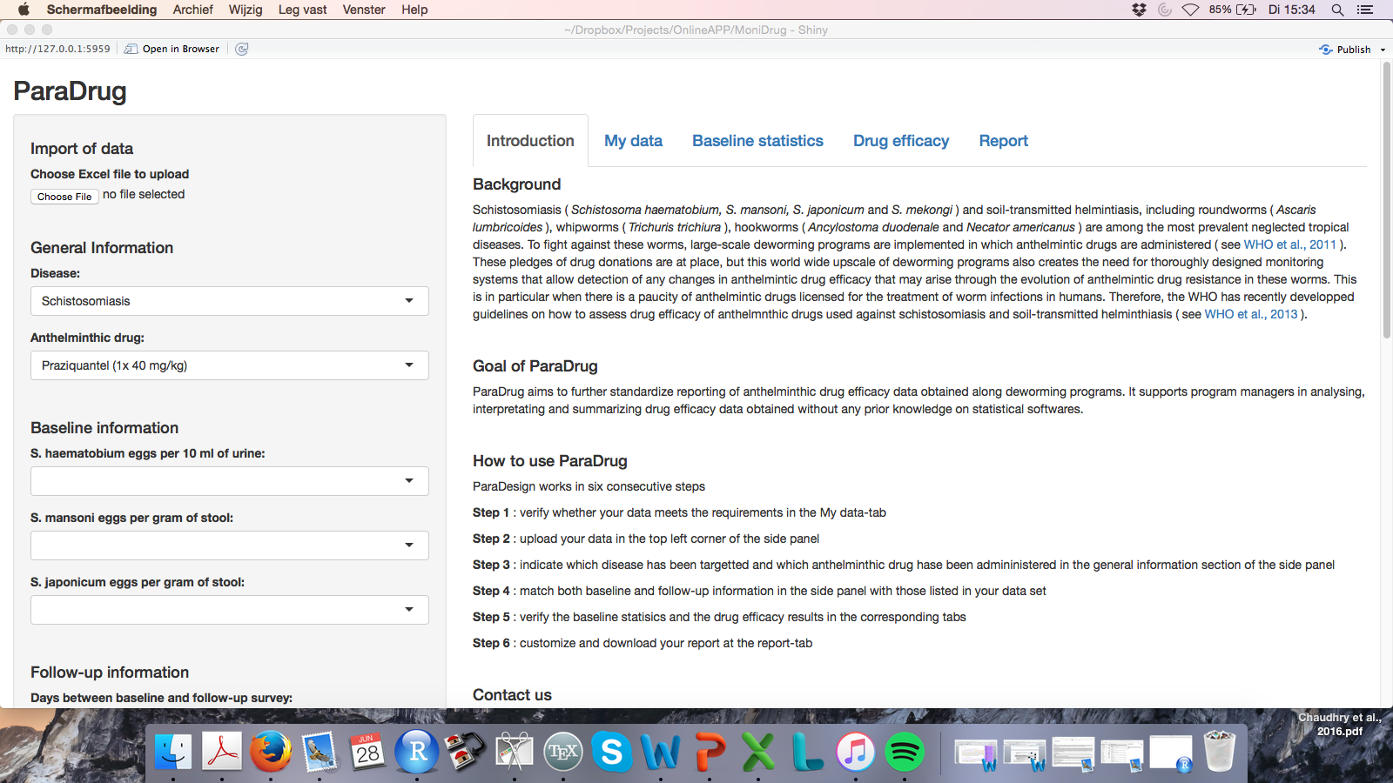
Start Page

Slide 3
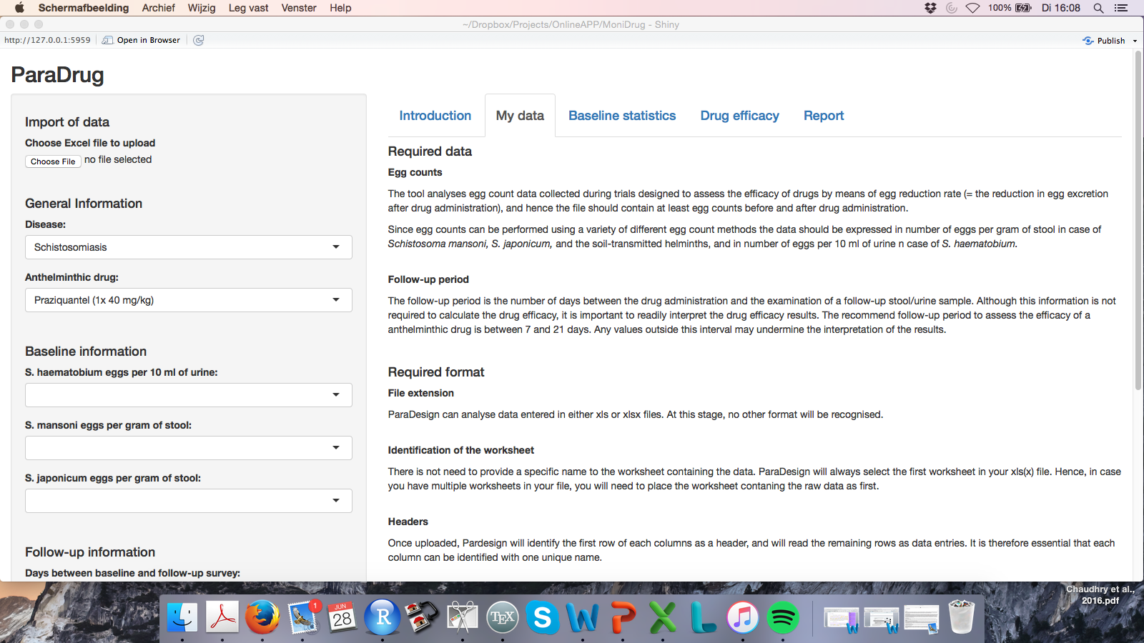
Check data requirements

Slide 4
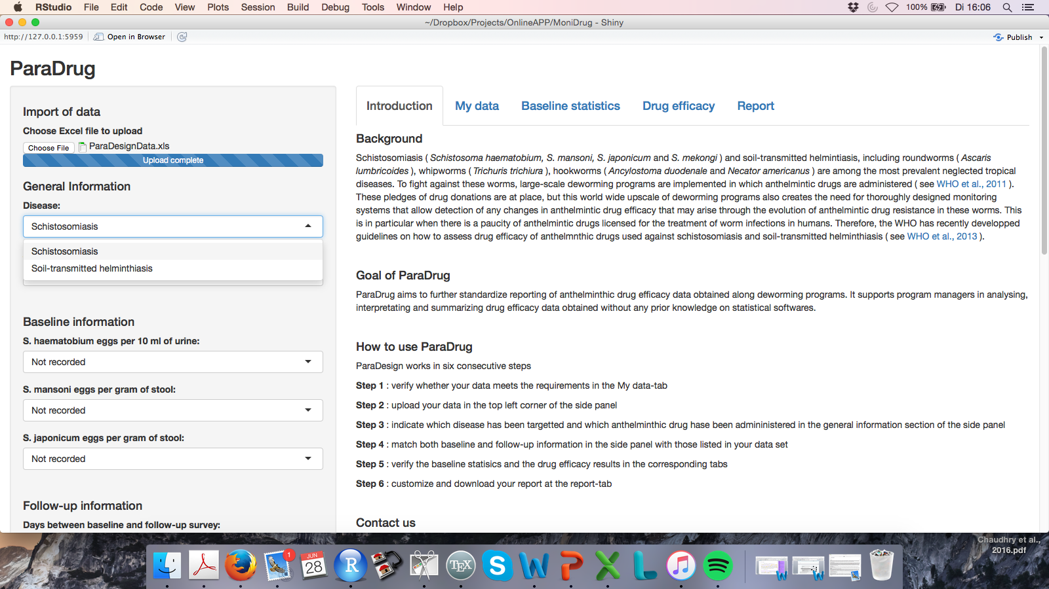
Choose Disease

Slide 5
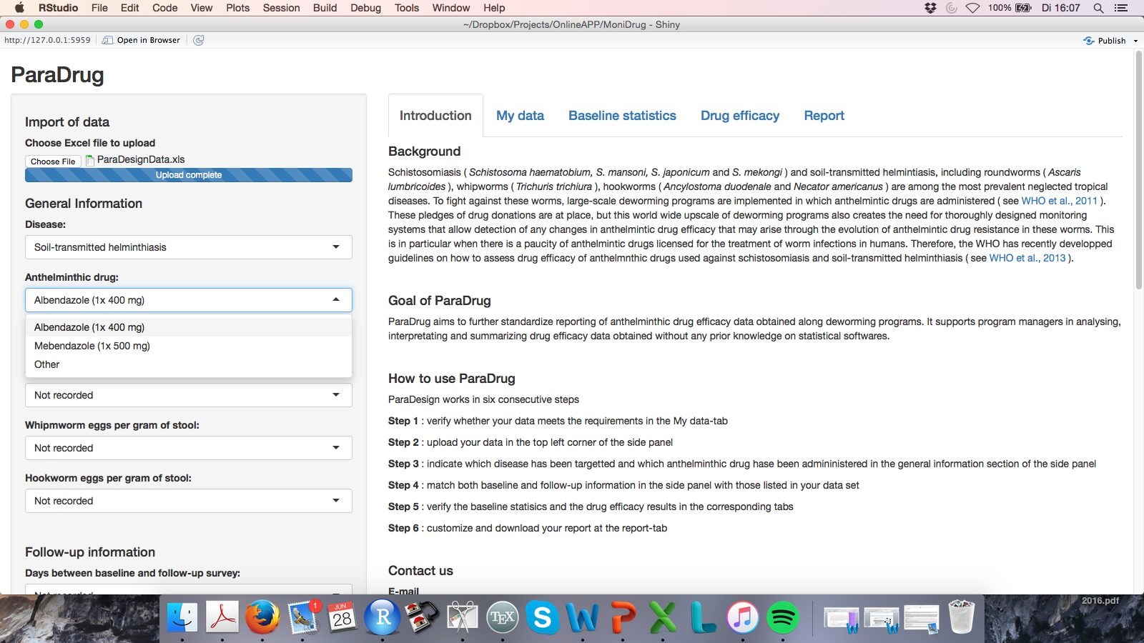
Choose drug

Slide 6
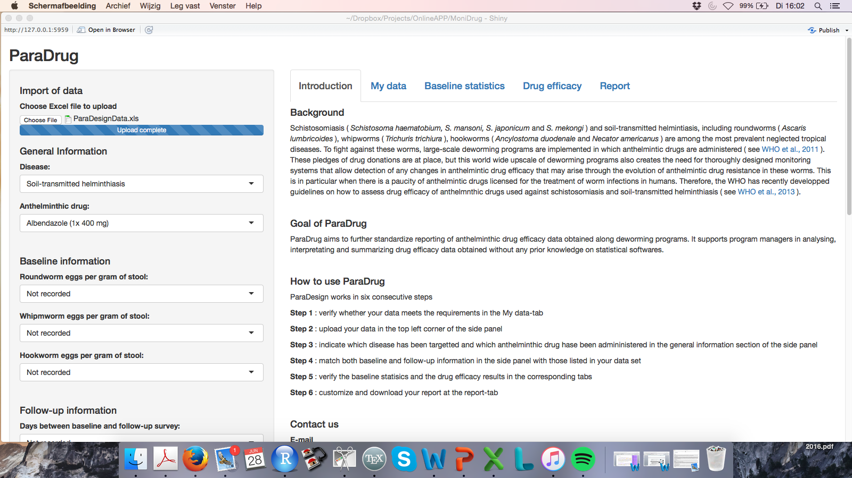
Upload data

Slide 7
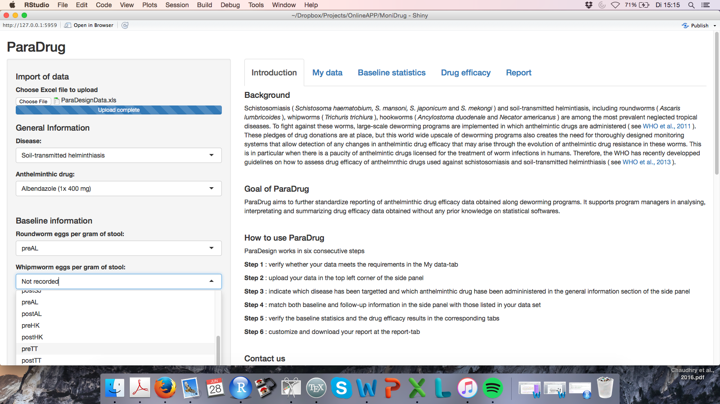
Link data

Slide 8
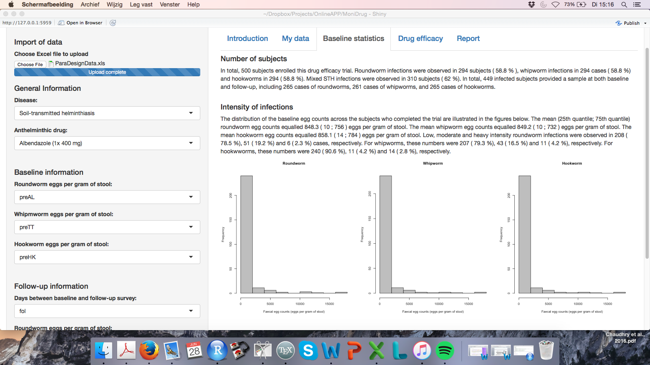
Baseline statistics

Slide 9
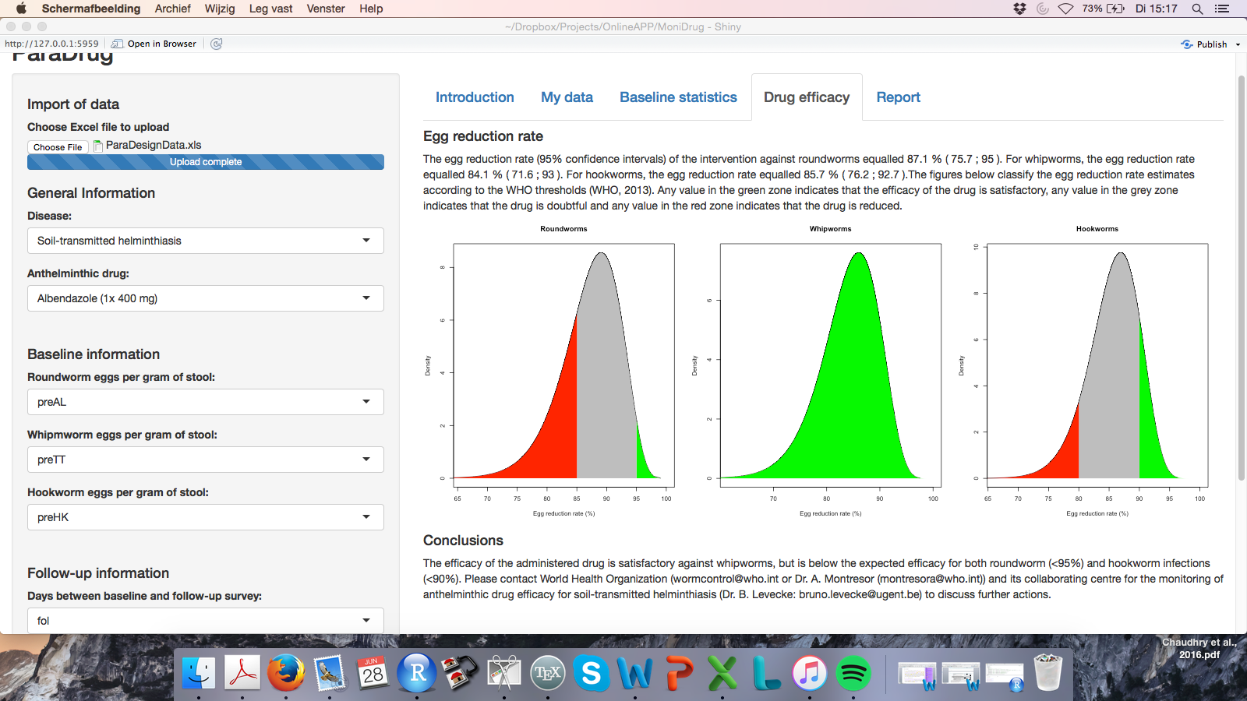
Drug efficacy

Slide 10
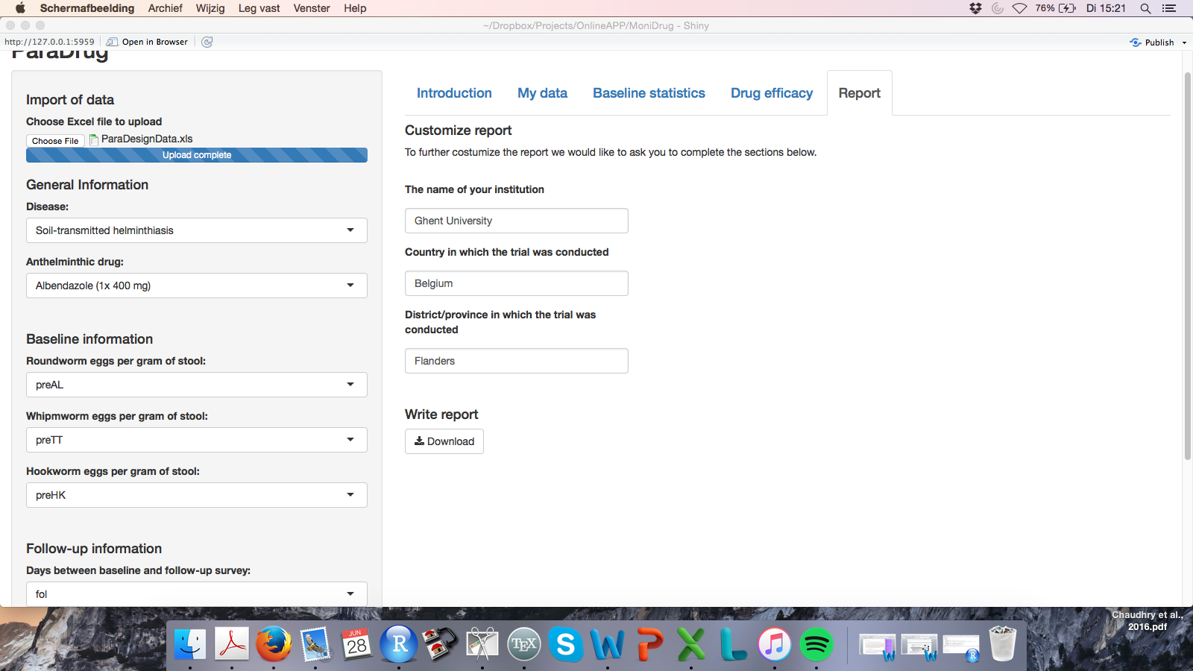
Customize Report

